Slide 1
Global optimisation of the Optimal Power Flow
Manuel Ruiz – RTE – manuel.ruiz@rte-france.com

Slide 2
A small example

Slide 3
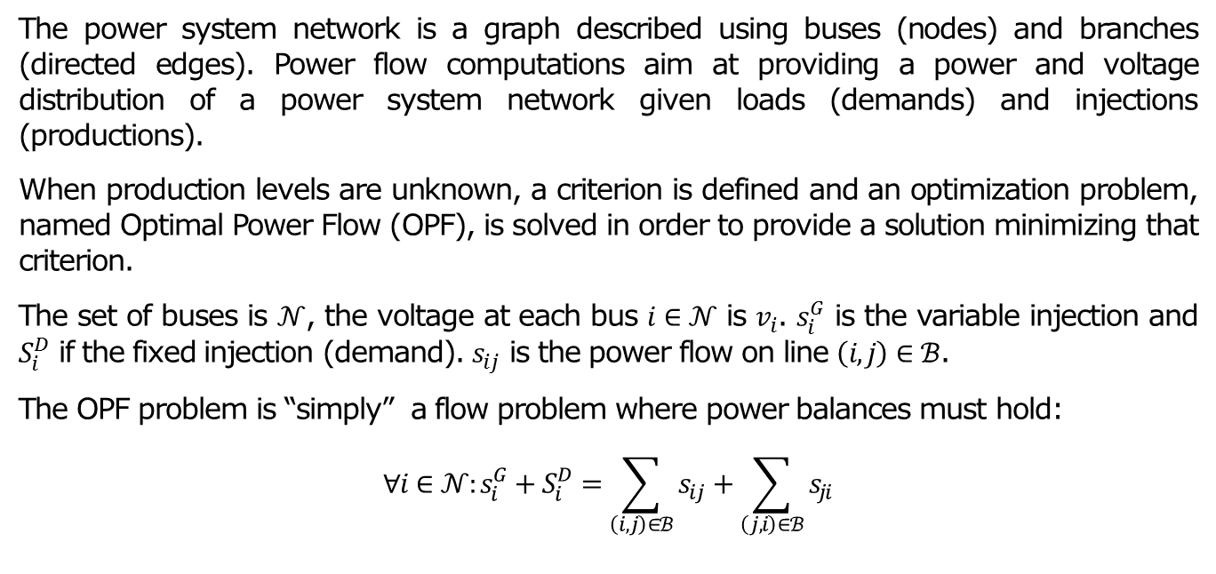
The Optimal Power Flow
  The power system network is a graph described using buses (nodes) and branches (directed edges). Power flow computations aim at providing a power and voltage distribution of a power system network given loads (demands) and injections (productions).
  When production levels are unknown, a criterion is defined and an optimization problem, named Optimal Power Flow (OPF), is solved in order to provide a solution minimizing that criterion.
  The set of buses is $𝒩$, the voltage at each bus $i∈𝒩$ is $v_{i}$. $s_{i}^{G}$ is the variable injection and $S_{i}^{D}$ if the fixed injection (demand). $s_{ij}$ is the power flow on line $\left(i,j\right)∈ℬ$.
  The OPF problem is “simply” a flow problem where power balances must hold:
  $$∀i∈𝒩:s_{i}^{G}+S_{i}^{D}=\sum_{\left(i,j\right)∈ℬ}{s_{ij}}+\sum_{\left(j,i\right)∈ℬ}{s_{ji}}$$

Slide 4
All variables are complex $(∈ℂ)$!

Slide 5
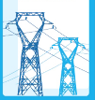
























Modeling of lines
  Physical lines are represented using a $π$ diagram. Power flow on lines are computed using the voltage and the current.
  $i_{lm}^{ }=\frac{Y_{lm}+Y_{lm}^{gr}}{{\left|ρ_{lm}\right|}^{2}}v_{l}−\frac{Y_{lm}}{ρ_{ml}{⋅ρ}_{lm}^{H}}v_{m}$
  $$\left[\begin{matrix}i_{lm} \\ i_{ml}\end{matrix}\right]=Y_{lm}\left[\begin{matrix}v_{l} \\ v_{m}\end{matrix}\right]$$
  $$s_{lm}=v_{l}⋅i_{lm}^{H}=…v_{l}v_{m}^{H}+…v_{l}v_{l}^{H}$$
  $$s_{ml}=v_{m}⋅i_{ml}^{H}=…v_{m}v_{l}^{H}+…v_{m}v_{m}^{H}$$
$$i_{lm}$$
$$i_{ml}$$
$$⟺$$
$$l$$
$$m$$
$$v_{l}$$
$$v_{m}$$
$$⟺$$
$$\frac{v_{m}}{ρ_{lm}}$$
$$\frac{v_{l}}{ρ_{ml}}$$
$$ρ_{lm}$$
$$ρ_{ml}$$
$$v_{l}$$
$$v_{m}$$
$$l$$
$$Y_{lm}$$
$$m$$
$$i_{lm}$$
$${ρ_{lm}^{H}i}_{lm}$$
$${ρ_{ml}^{H}i}_{ml}$$
$$i_{ml}$$
$$Y_{lm}^{gr}$$
$$Y_{ml}^{gr}$$

Slide 6
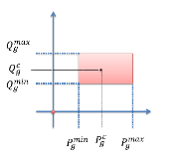

Injection on buses
  For each variable injection units, the feasible domain of the active and reactive power injected is given. Conventional units can be switched on/off, $(P_{g}^{c},Q_{g}^{c})$ is the expected production level, bounds on active and reactive power are also defined.
  Fixed injections on buses are associated with loads or with renewable production, they are production that should not be modified. But in order to reach a feasible point, production curtailment (reduction of fixed production) and load shedding (reduction of fixed demand) can be used.

Slide 7
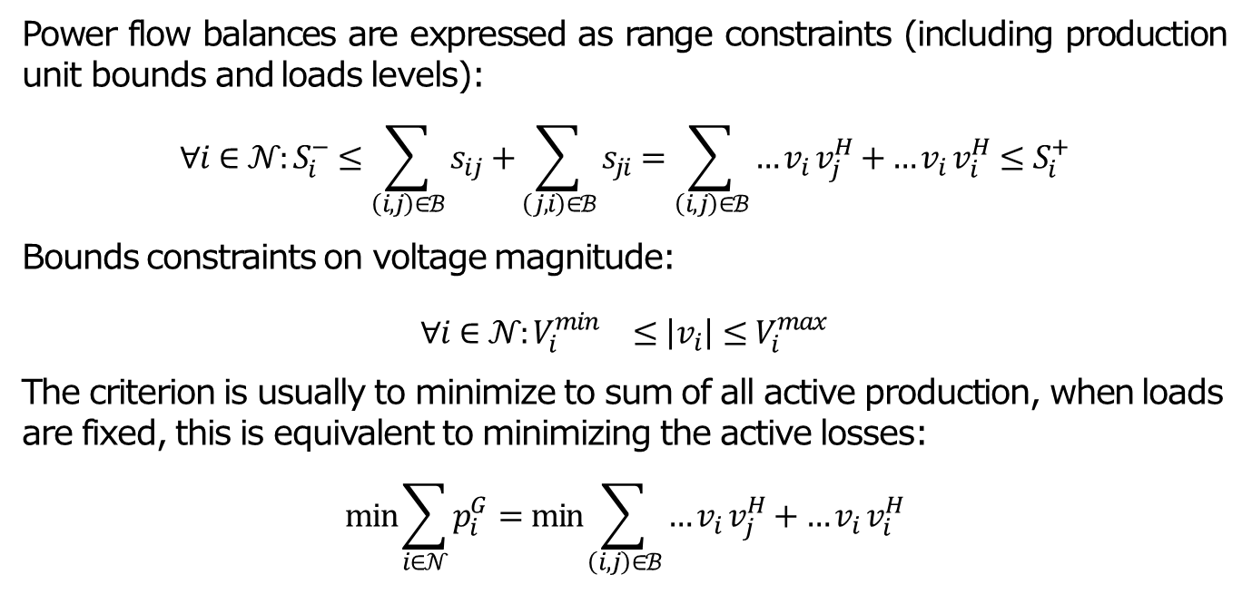
The simplest OPF problem
  Power flow balances are expressed as range constraints (including production unit bounds and loads levels):
  $$∀i∈𝒩:S_{i}^{−}≤\sum_{\left(i,j\right)∈ℬ}{s_{ij}}+\sum_{\left(j,i\right)∈ℬ}{s_{ji}}=\sum_{\left(i,j\right)∈ℬ}{{…v}_{i}v_{j}^{H}+{…v}_{i}v_{i}^{H}}≤S_{i}^{+}$$
  Bounds constraints on voltage magnitude:
  $$∀i∈𝒩:{V_{i}^{min}}^{}≤\left|v_{i}\right|≤V_{i}^{max}$$
  The criterion is usually to minimize to sum of all active production, when loads are fixed, this is equivalent to minimizing the active losses:
  $$\min{\sum_{i∈𝒩}{p_{i}^{G}}}=\min{\sum_{\left(i,j\right)∈ℬ}{{…v}_{i}v_{j}^{H}+{…v}_{i}v_{i}^{H}}}$$

Slide 8
Global optimisation of the OPF

Slide 9
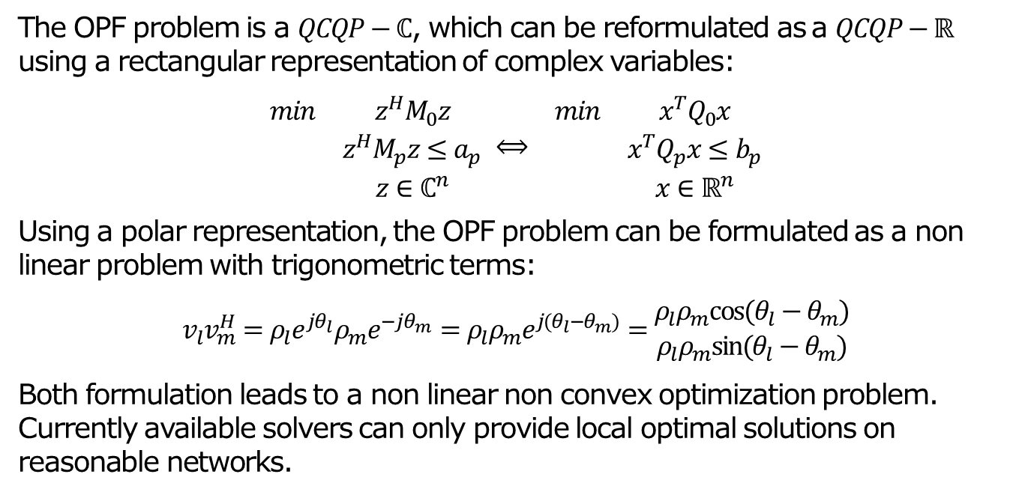
General formulation
  The OPF problem is a $QCQP−ℂ$, which can be reformulated as a $QCQP−ℝ$ using a rectangular representation of complex variables:
  $$\begin{matrix}\begin{matrix}min & z^{H}M_{0}z \\ \begin{aligned} \\ \end{aligned} & \begin{aligned}z^{H}M_{p}z≤a_{p} \\ z∈ℂ^{n}\end{aligned}\end{matrix}\end{matrix} \begin{matrix}⟺ & \begin{matrix}min & x^{T}Q_{0}x \\ \begin{aligned} \\ \end{aligned} & \begin{aligned}x^{T}Q_{p}x≤b_{p} \\ x∈ℝ^{n}\end{aligned}\end{matrix}\end{matrix}$$
  Using a polar representation, the OPF problem can be formulated as a non linear problem with trigonometric terms:
  $$v_{l}v_{m}^{H}=ρ_{l}e^{jθ_{l}}ρ_{m}e^{−jθ_{m}}=ρ_{l}ρ_{m}e^{j(θ_{l}−θ_{m})}=\begin{matrix}ρ_{l}ρ_{m}cos⁡(θ_{l}−θ_{m}) \\ ρ_{l}ρ_{m}sin⁡(θ_{l}−θ_{m})\end{matrix}$$
  Both formulation leads to a non linear non convex optimization problem. Currently available solvers can only provide local optimal solutions on reasonable networks.

Slide 10
Motivations
  At RTE, good solutions are obtained with the interior point method implemented in ARTELYS-KNITRO. We managed to solve very large scale OPF problem (see PEGASE or iTESLA projects).
  10000 nodes, 15000 lines, more complex devices set up on lines (PST) or buses (on/off production units and shunts)
  But when a local optimization solver crashed, is it because the problem is unfeasible or not ? It is impossible to answer the question with a local optimization method.
  It is very difficult to deploy a numerical module based on local optimization solver, global optimization method can then be used to prove the optimality of a solution.

Slide 11
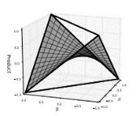
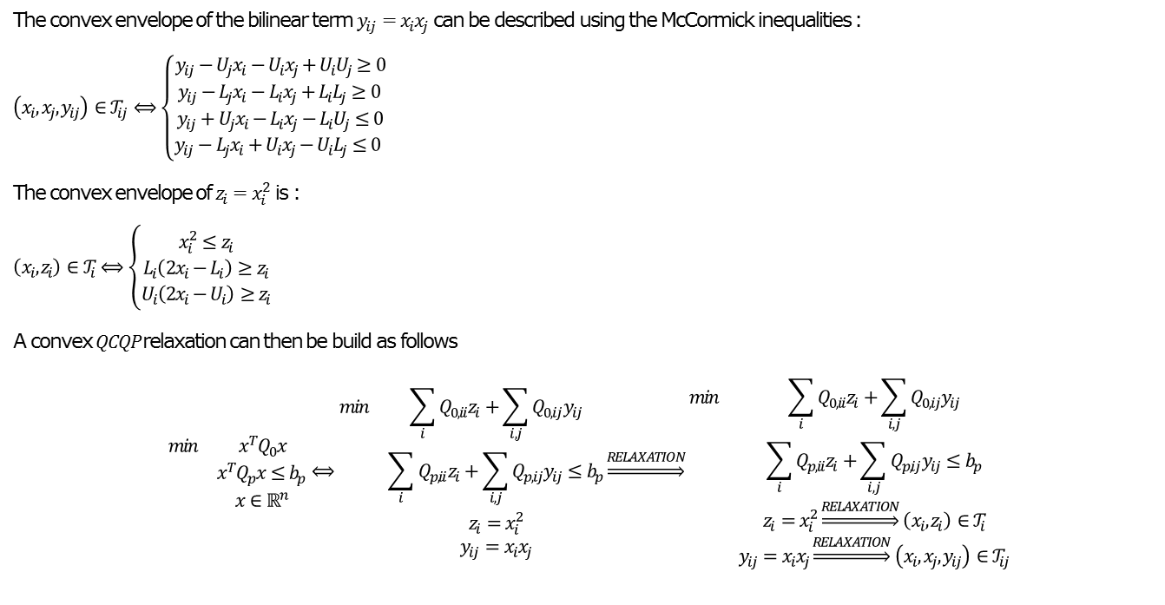
Convex QCQP relaxations
  The convex envelope of the bilinear term $y_{ij}=x_{i}x_{j}$ can be described using the McCormick inequalities :
  $$\left(x_{i},x_{j},y_{ij}\right)∈𝒯_{ij}⟺\left\{\begin{matrix}y_{ij}−U_{j}x_{i}−U_{i}x_{j}+U_{i}U_{j}≥0 \\ y_{ij}−L_{j}x_{i}−L_{i}x_{j}+L_{i}L_{j}≥0 \\ y_{ij}+U_{j}x_{i}−L_{i}x_{j}−L_{i}U_{j}≤0 \\ y_{ij}−L_{j}x_{i}+U_{i}x_{j}−U_{i}L_{j}≤0 \end{matrix}\right.$$
  The convex envelope of $z_{i}=x_{i}^{2}$ is :
  $$\left(x_{i},z_{i}\right)∈𝒯_{i}⟺\left\{\begin{aligned}x_{i}^{2}≤z_{i} \\ L_{i}\left(2x_{i}−L_{i}\right)≥z_{i} \\ U_{i}\left(2x_{i}−U_{i}\right)≥z_{i}\end{aligned}\right.$$
  A convex $QCQP$relaxation can then be build as follows
  $$\begin{matrix}min & x^{T}Q_{0}x \\ \begin{aligned} \\ \end{aligned} & \begin{aligned}x^{T}Q_{p}x≤b_{p} \\ x∈ℝ^{n}\end{aligned}\end{matrix}⟺\begin{matrix}min & \sum_{i}{Q_{0,ii}z_{i}}+\sum_{i,j}{Q_{0,ij}y_{ij}} \\ \begin{aligned} \\ \end{aligned} & \begin{aligned}\sum_{i}{Q_{p,ii}z_{i}}+\sum_{i,j}{Q_{p,ij}y_{ij}}≤b_{p} \\ z_{i}=x_{i}^{2} \\ y_{ij}=x_{i}x_{j}\end{aligned}\end{matrix}\underset{⇒}{RELAXATION}\begin{matrix}min & \sum_{i}{Q_{0,ii}z_{i}}+\sum_{i,j}{Q_{0,ij}y_{ij}} \\ \begin{aligned} \\ \end{aligned} & \begin{aligned}\sum_{i}{Q_{p,ii}z_{i}}+\sum_{i,j}{Q_{p,ij}y_{ij}}≤b_{p} \\ z_{i}=x_{i}^{2}\underset{⇒}{RELAXATION}\left(x_{i},z_{i}\right)∈𝒯_{i} \\ y_{ij}=x_{i}x_{j}\underset{⇒}{RELAXATION}\left(x_{i},x_{j},y_{ij}\right)∈𝒯_{ij}\end{aligned}\end{matrix}$$

Slide 12
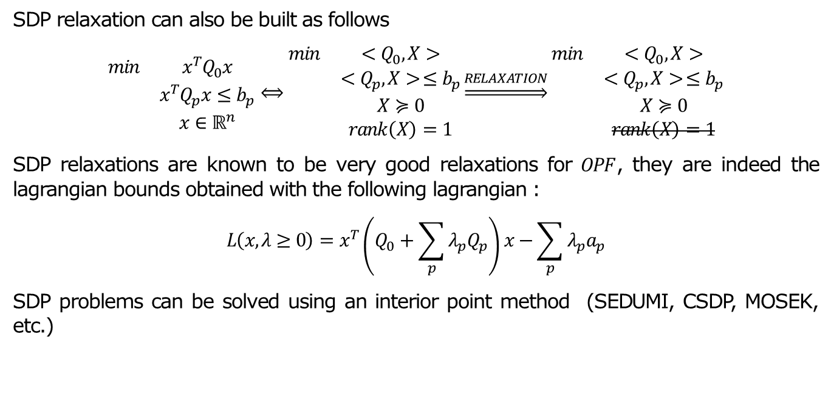
SDP relaxations / rank relaxation
  SDP relaxation can also be built as follows
  $$\begin{matrix}min & x^{T}Q_{0}x \\ \begin{aligned} \\ \end{aligned} & \begin{aligned}x^{T}Q_{p}x≤b_{p} \\ x∈ℝ^{n}\end{aligned}\end{matrix}⟺\begin{matrix}min & {<Q}_{0},X> \\ \begin{aligned} \\ \end{aligned} & \begin{aligned}{<Q}_{p},X> ≤b_{p} \\ X≽0 \\ rank\left(X\right)=1\end{aligned}\end{matrix}\underset{⇒}{RELAXATION}\begin{matrix}min & {<Q}_{0},X> \\ \begin{aligned} \\ \end{aligned} & \begin{aligned}{<Q}_{p},X> ≤b_{p} \\ X≽0 \\ rank\left(X\right)=1\end{aligned}\end{matrix}$$
  SDP relaxations are known to be very good relaxations for $OPF$, they are indeed the lagrangian bounds obtained with the following lagrangian :
  $$L\left(x, λ≥0\right)=x^{T}\left(Q_{0}+\sum_{p}{λ_{p}Q_{p}}\right)x−\sum_{p}{λ_{p}a_{p}}$$
  SDP problems can be solved using an interior point method (SEDUMI, CSDP, MOSEK, etc.)

Slide 13
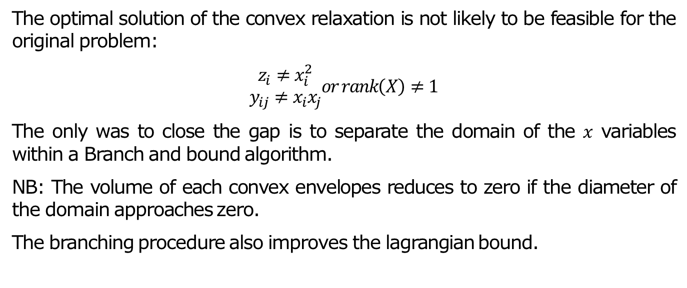
Spatial Branch And Bound
  The optimal solution of the convex relaxation is not likely to be feasible for the original problem:
  $$\begin{aligned}z_{i}≠x_{i}^{2} \\ y_{ij}≠x_{i}x_{j}\end{aligned}or rank\left(X\right)≠1$$
  The only was to close the gap is to separate the domain of the $x$ variables within a Branch and bound algorithm.
  NB: The volume of each convex envelopes reduces to zero if the diameter of the domain approaches zero.
  The branching procedure also improves the lagrangian bound.

Slide 14
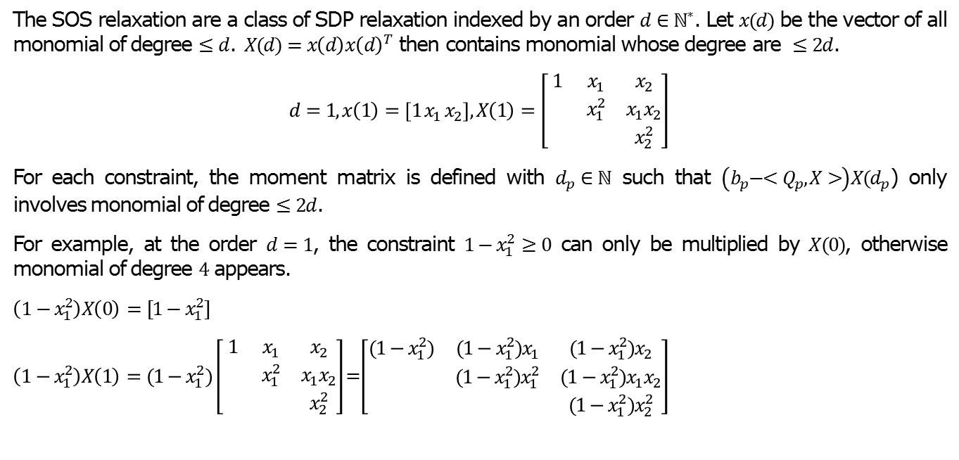
Sum Of Square Relaxation
  The SOS relaxation are a class of SDP relaxation indexed by an order $d∈ℕ^{∗}$. Let $x(d)$ be the vector of all monomial of degree $≤d$. $X(d)=x\left(d\right)x{\left(d\right)}^{T}$ then contains monomial whose degree are $≤2d$.
  $$d=1, x\left(1\right)=\left[1 x_{1} x_{2}\right], X\left(1\right)=\left[\begin{matrix}1 & x_{1} & x_{2} \\ & x_{1}^{2} & x_{1}x_{2} \\ & & x_{2}^{2}\end{matrix}\right]$$
  For each constraint, the moment matrix is defined with $d_{p}∈ℕ$ such that $\left(b_{p}−{<Q}_{p},X>\right)X(d_{p}$) only involves monomial of degree $≤2d$.
  For example, at the order $d=1$, the constraint $1−x_{1}^{2}≥0$ can only be multiplied by $X(0)$, otherwise monomial of degree $4$ appears.
  $\left(1−x_{1}^{2}\right)X\left(0\right)=[1−x_{1}^{2}]$
  $\left(1−x_{1}^{2}\right)X\left(1\right)=(1−x_{1}^{2})\left[\begin{matrix}1 & x_{1} & x_{2} \\ & x_{1}^{2} & x_{1}x_{2} \\ & & x_{2}^{2}\end{matrix}\right]$=$\left[\begin{matrix}(1−x_{1}^{2}) & (1−x_{1}^{2})x_{1} & {(1−x_{1}^{2})x}_{2} \\ & (1−x_{1}^{2})x_{1}^{2} & (1−x_{1}^{2})x_{1}x_{2} \\ & & (1−x_{1}^{2})x_{2}^{2}\end{matrix}\right]$

Slide 15
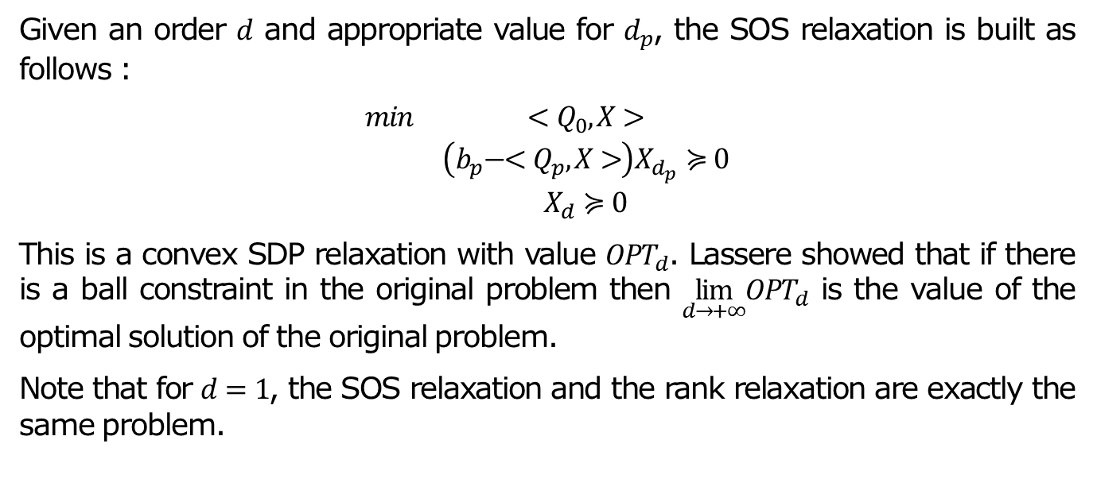
Sum Of Square Relaxation
  Given an order $d$ and appropriate value for $d_{p}$, the SOS relaxation is built as follows :
  $$\begin{matrix}min & {<Q}_{0},X> \\ \begin{aligned} \\ \end{aligned} & \begin{aligned}\left(b_{p}−{<Q}_{p},X>\right)X_{d_{p}}≽0 \\ X_{d}≽0\end{aligned}\end{matrix}$$
  This is a convex SDP relaxation with value $OPT_{d}$. Lassere showed that if there is a ball constraint in the original problem then $\lim_{d→+∞}OPT_{d}$ is the value of the optimal solution of the original problem.
  Note that for $d=1$, the SOS relaxation and the rank relaxation are exactly the same problem.

Slide 16
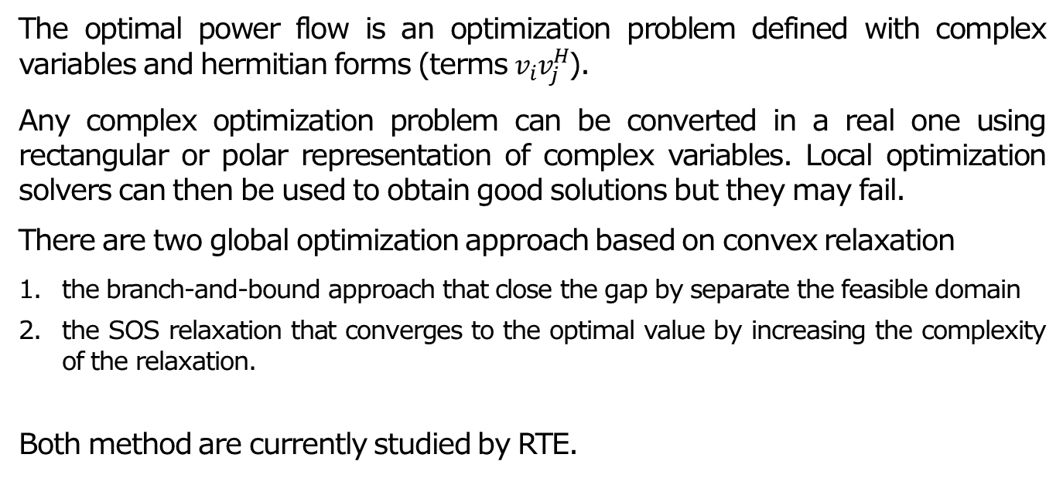
Conclusion
  The optimal power flow is an optimization problem defined with complex variables and hermitian forms (terms $v_{i}v_{j}^{H}$).
  Any complex optimization problem can be converted in a real one using rectangular or polar representation of complex variables. Local optimization solvers can then be used to obtain good solutions but they may fail.
  There are two global optimization approach based on convex relaxation
    the branch-and-bound approach that close the gap by separate the feasible domain
    the SOS relaxation that converges to the optimal value by increasing the complexity of the relaxation.
  Both method are currently studied by RTE.

Slide 17
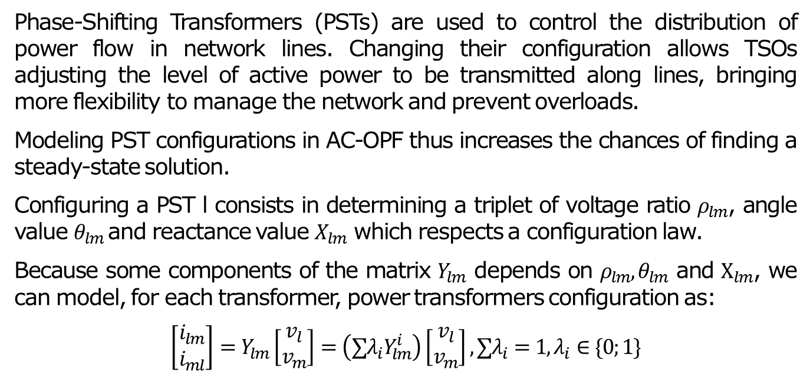
Lines with PST
  Phase-Shifting Transformers (PSTs) are used to control the distribution of power flow in network lines. Changing their configuration allows TSOs adjusting the level of active power to be transmitted along lines, bringing more flexibility to manage the network and prevent overloads.
  Modeling PST configurations in AC-OPF thus increases the chances of finding a steady-state solution.
  Configuring a PST l consists in determining a triplet of voltage ratio $ρ_{lm}$, angle value $θ_{lm}$and reactance value $X_{lm}$ which respects a configuration law.
  Because some components of the matrix $Y_{lm}$ depends on $ρ_{lm}, θ_{lm}$ and $X_{lm}$, we can model, for each transformer, power transformers configuration as:
  $$\left[\begin{matrix}i_{lm} \\ i_{ml}\end{matrix}\right]=Y_{lm}\left[\begin{matrix}v_{l} \\ v_{m}\end{matrix}\right]=\left(∑λ_{i}Y_{lm}^{i}\right)\left[\begin{matrix}v_{l} \\ v_{m}\end{matrix}\right], ∑λ_{i}=1, λ_{i}∈\{0;1\}$$

