Slide 1
Optimization of a battery storage with stochastic consumption and production
Erwan Pierre – EDF R&D
SESO 2018 International Thematic Week
- Smart Energy and Stochastic Optimization

Slide 2
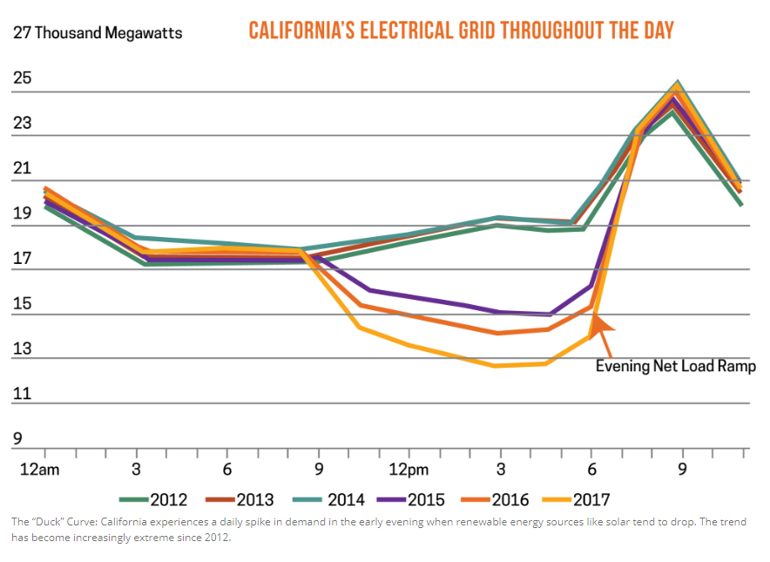
High penetration of renewable energy generation on the grid require new approaches to extending and operating the grid.
Legislation tends to favour self-consumption for small local production.
Source : CPower Energy Management

Slide 3
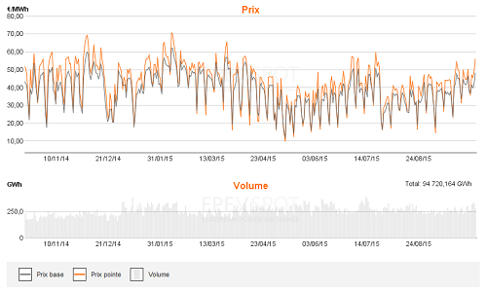
Production
Consumption
Network
When it’s the best moment to charge and discharge the battery ?
Spot prices
Stochastic Consumption
Stochastic Production

Slide 4
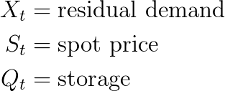
The model : 3 state variables – 1 control under constraint
State variables
Balance constraint
Control
Inverter constraint

Slide 5
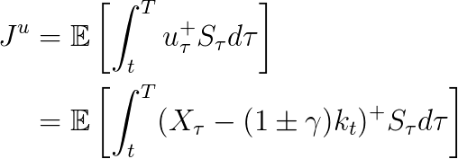
The objective function : we recall that the objective is to find the best charge/discharge strategy to minimize the cost from the calls on network.

Slide 6
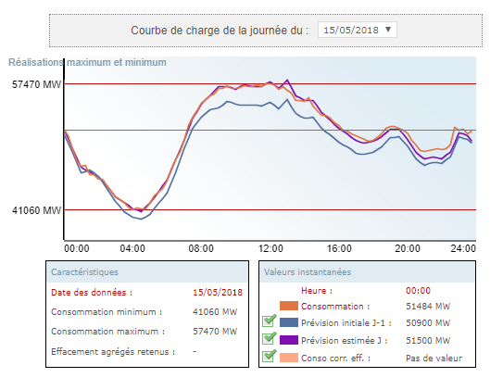
Stochastic Optimization vs Deterministic Optimization
Price data
At a more local level, the consumption can be harder to predict even the day ahead so we solve a stochastic control problem.
Conso data
Prod data
16h
0h
24h
Source : RTE

Slide 7
We model the residual demand by an Ornstein Uhlenbeck model :
And the spot price as a two factor model (deformation of the initial forward curve) :

Slide 8
The value function is the minimization of the cost function so :
Under some classical constraints, we know that the value function V is a viscosity solution of the following Hamilton-Jacobi-Bellman (HJB) equation :

Slide 9
We then have the following form expression for the optimal control policy :

Slide 10
Numerical resolution: we use a classic Longstaff-Schwartz method to solve the problem.
Number of simulations : 100 000
Grid : 1000 storage points
Size of the mesh for the regression : 6
Linear regression

Slide 11
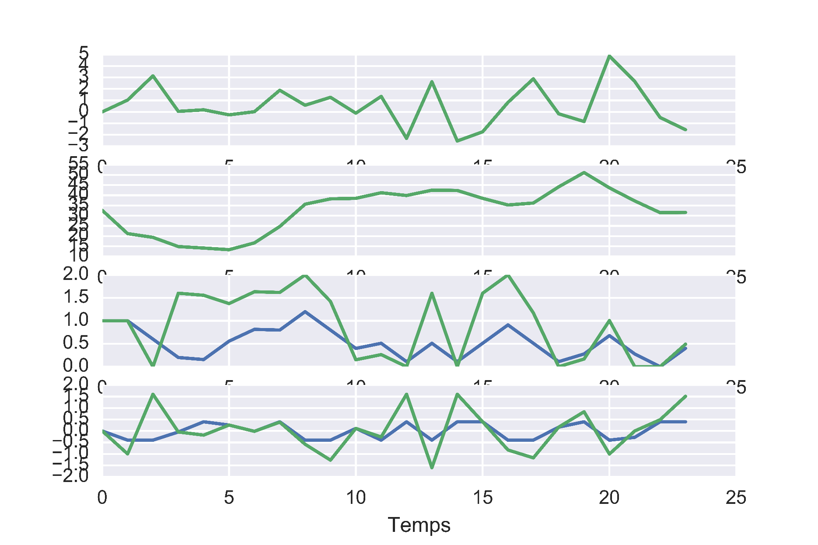
Optimal storage strategy for 2 characteristics of inverter
Inverter characteristics
Residual consumption
20%
80%
Spot price
Storage level
Charge

Slide 12
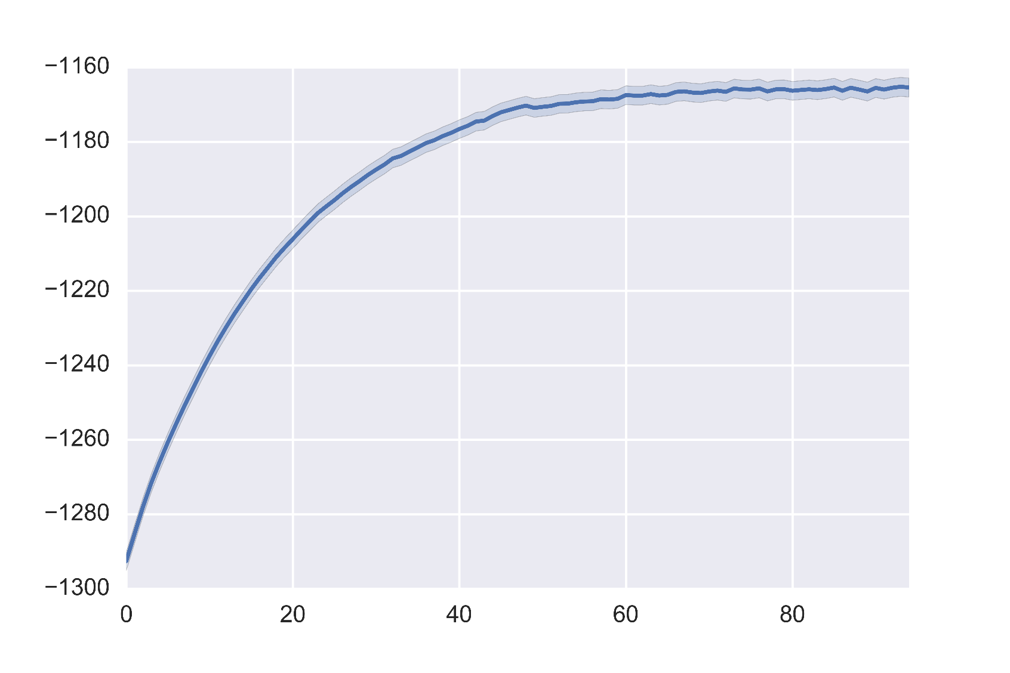
Value function
Inverter charge speed (%)

Slide 13
Conclusion
Estimate the potential profit from a storage installation.
Choose the optimal characteristics of the battery and inverter.
Give the optimal charge/discharge strategy in a stochastic environment.

