Slide 1
Quantitative tools for the sustainable recovery
of the hake (Merluccius Gayi Gayi) in the Region
of Valparaiso, Chile
Mathematics of Bio-Economics (MABIES)
February 6, 2013 - Institut Henri Poincaré – Paris - France

Slide 2
Project started at August, 2011
Duration 1.5 year
Current Stage Online tool on final development stage
Project website www.recuperemoslamerluza.cl
Financial support Regional Government (GoRe) Valparaiso; Program for the Innovation & Competitiveness (FIC)
This project has been carried by a multidisciplinary team and has been leading by Department of Mathematics, Universidad Técnica Federico Santa María, Chile.

Slide 3
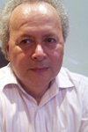
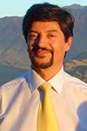
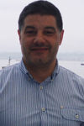
Research
Team
PEDRO
GAJARDO
HÉCTOR
RAMÍREZ
RESEARCHER ON
MATHEMATICAL
MODELLING
PROJECT DIRECTOR
RESEARCHER ON
MATHEMATICAL
MODELLING
ADJOINT DIRECTOR
ALEJANDRO
ZULETA
DARÍO
RIVAS
Multidisciplinary Group
Marine Biologists
Engineers
Applied Mathematicians
Expert on social behavior
Journalist
RESEARCHER ON
FISHERIES STOCK
ASSESMENT
RESEARCHER ON
FISHERIES
MANAGEMENT
RENZO
TASCHERI
MAXIMILIANO
OLIVARES
MARINE
BIOLOGIST
MATHEMATICAL
ENGINEERING
STUDENT
COLLABORATORS
GILDA MEDINA | JOURNALIST
HÉCTOR TRUJILLO | SOFTSYSTEMS ANALYSIS GROUP (VENEZUELA)
ANGGELO URSO | COMPUTER ENGINEERING

Slide 4
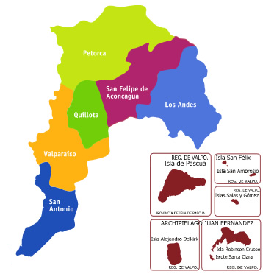
Hake
Fishery
Oldest and most important demersal fishery in Chile
Main fishery resource of the Region of Valparaiso

Slide 5
Hake
Fishery
In the last decade, the South Pacific Hake's (Merluccius Gayi Gayi) fishery has been very damaged
SOME DISCUSSED EXPLAINATIONS
OVEREXPLOITATION
APPARITION OF
NEW PREDATORS
GIANT
SQUID

Slide 6
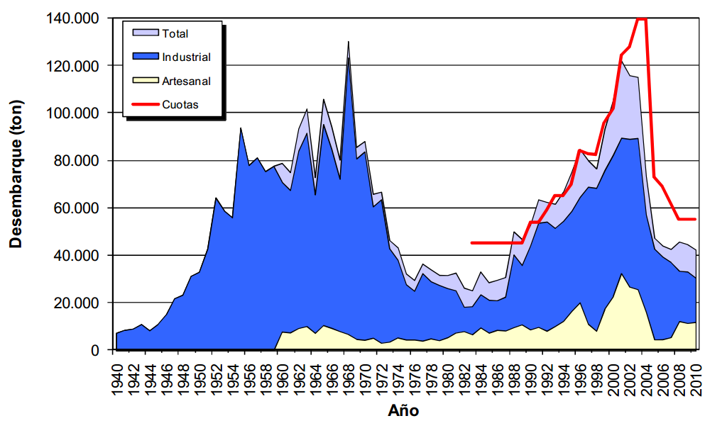
Hake
Fishery
This situation has led to a reduction of landings and, consequently, to a reduction of the artisan fleet in the Region of Valparaiso (Chile)
Landings (tonnes) of hake. The red line shows the annual global catch quota established and approved by the CNP since 1992.
Source: Technical Report (R.Pesq.) N°117/2011

Slide 7
The aim of this project is to provide quantitative tools to propose recovery strategies for this fishery

Slide 8
Stakeholders

Slide 9
Stakeholders
Yields
Landings / catches

Slide 10
Stakeholders
SSB Spawning
Stock Biomass
Yields
Landings / catches
Prevention

Slide 11
Stakeholders
SSB Spawning
Stock Biomass
Yields
Landings / catches
Prevention
Level of yields required by the local community
Social
Requirement

Slide 12
Stakeholders
Prevention
Yields
SSB Spawning
Stock Biomass
Landings / catches
Social
Requirement
Level of yields required by the local community

Slide 13
Stakeholders
Prevention
Yields
SSB Spawning
Stock Biomass
Landings / catches
Social
Requirement
Level of yields required by the local community
Recovery Plan
Proposal

Slide 14
Stakeholders
Prevention
Yields
SSB Spawning
Stock Biomass
Landings / catches
Social
Requirement
Level of yields required by the local community
Recovery Plan
Proposal
BIOLOGICAL INDICATORS
Spawning Stock Biomass
Total Biomass

Slide 15
Stakeholders
Prevention
Yields
SSB Spawning
Stock Biomass
Landings / catches
Social
Requirement
Level of yields required by the local community
Recovery Plan
Proposal
BIOLOGICAL INDICATORS
Spawning Stock Biomass
Total Biomass
ECONOMICAL INDICATORS
Landings
Economical return of the fleets

Slide 16
Stakeholders
Prevention
Yields
SSB Spawning
Stock Biomass
Landings / catches
Social
Requirement
Level of yields required by the local community
Recovery Plan
Proposal
BIOLOGICAL INDICATORS
Spawning Stock Biomass
Total Biomass
ECONOMICAL INDICATORS
Landings
Economical return of the fleets
The plan will be optimal in some predefined sense

Slide 17
Stakeholders
Meetings with stakeholders

Slide 18
Stakeholders
Meetings with stakeholders
To introduce the project
To obtain feedback

Slide 19
Stakeholders
Meetings with stakeholders
To introduce the project
To obtain feedback
Bottom-up relation with the different actors involved in the fishery management

Slide 20
Stakeholders
Stage I
Visiting local fishing bays
Stage II
Interviews with stakeholders in the
Region of Valparaiso
3 Stages
Stage III WORKSHOP
“Identifying the main problems for the recovery of hake”

Slide 21
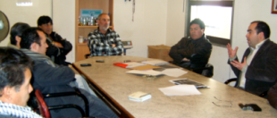
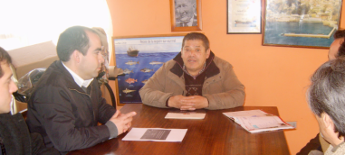
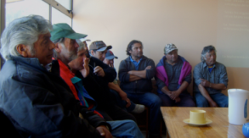
Stakeholders
Stage I
Visiting local fishing bays
Stage II
Interviews with stakeholders in the
Region of Valparaiso
3 Stages
Stage III WORKSHOP
“Identifying the main problems for the recovery of hake”

Slide 22
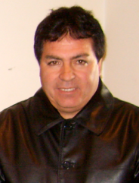
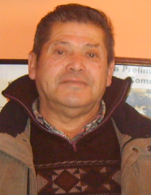
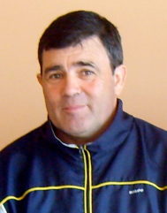
Stakeholders
Valparaíso
Stage I
Eduardo Quiroz
“Portales”
Visiting local fishing bays
Stage II
Valparaíso
Interviews with stakeholders in the
Region of Valparaiso
3 Stages
Gabriel Valenzuela
“El Membrillo”
Stage III WORKSHOP
San Antonio
“Identifying the main problems for the recovery of hake”
Miguel Ángel Hernández
“Puertecito”

Slide 23
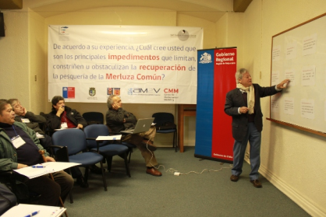
Stakeholders
Stage I
Visiting local fishing bays
Stage II
Interviews with stakeholders in the
Region of Valparaiso
3 Stages
Stage III WORKSHOP
“Identifying the main problems for the recovery of hake”

Slide 24
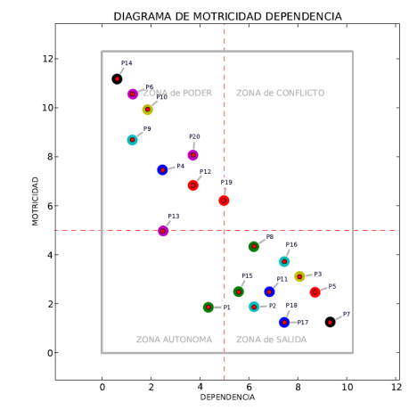
Workshop
“Identifying the main problems for the recovery of hake”
From interviews and email consults to different stakeholders (in the Region of Valparaiso), were identified 20 ‘macroproblems’
Some key macroproblems
The State, the Academy, Civil Society and Business (Industrial-Artisan Fisheries) operating as bubbles
There is no a joint sociopolitical vision for the
exploitation of the hake fishery

Slide 25
Technological Transfer
WEBWARE
WEB APPLICATION
OPEN ACCESS
FISHERIES
STOCK
ASSESSMENT
WORKSHOPS &
STAKEHOLDERS
RESEARCH
TEAM
THEORY

Slide 26
Technological Transfer
WEBWARE
WEB APPLICATION
OPEN ACCESS
FISHERIES
STOCK
ASSESSMENT
WORKSHOPS &
STAKEHOLDERS
RESEARCH
TEAM
THEORY

Slide 27
Technological Transfer
WEBWARE
WEB APPLICATION
OPEN ACCESS
FISHERIES
STOCK
ASSESSMENT
WORKSHOPS &
STAKEHOLDERS
RESEARCH
TEAM
THEORY

Slide 28
Theory
BASIC IDEAS

Slide 29
Theory
BASIC IDEAS
FISHERIES DATA
ESTIMATION
ABUNDANCE
ESTIMATION
MEAN
WEIGHT
+ OTHERS

Slide 30
Theory
BASIC IDEAS
FISHERIES DATA
ESTIMATION
N
ABUNDANCE VECTOR
OR STATE
ABUNDANCE
ESTIMATION
MEAN
WEIGHT
+ OTHERS

Slide 31
Theory
BASIC IDEAS
N
INITIAL STATE
0

Slide 32
Theory
BASIC IDEAS
Yields | Landings | Catches
FROM
N
0
Y
[ktonnes]
…
N
t
[years]
t
0
INITIAL STATE
0
Yields from some strategy

Slide 33
Theory
BASIC IDEAS
Yields | Landings | Catches
FROM
N
0
Y
[ktonnes]
…
y
min
N
t
[years]
t
0
INITIAL STATE
0
We focus on minimal sustainable value for yield
y
min

Slide 34
Theory
FROM
Y
N
0
BASIC IDEAS
[ktonnes]
…
y
min
[years]
t
By modifying the exploitation strategy
FROM
Y
N
0
y
N
[ktonnes]
…
min
0
INITIAL STATE
y
min
[years]
t
y
We seek strategies which ensures instead of
y
min
min
as minimal sustainable value for yield

Slide 35
Theory
BASIC IDEAS
Yields | Landings | Catches
FROM
Y
N
0
Mm
y
[ktonnes]
…
min
y
min
y
min
[years]
t
N
INITIAL STATE
0
What is the maximum possible value for y_{min}?
?
y
y
min
min

Slide 36
Theory
BASIC IDEAS
Yields | Landings | Catches
FROM
N
0
Mm
y
min
N
INITIAL STATE
0
Mm
We can use this value to propose a recovery plan

Slide 37
Theory
Recovery
Problem
BASIC IDEAS
FROM
N
0
Mm
N
INITIAL STATE
0
Mm
Maximum possible value for y_{min}

Slide 38
Theory
Recovery
Problem
BASIC IDEAS
FROM
N
0
Mm
REQ
N
INITIAL STATE
0
Mm Maximum possible value for y_{min}
Social required level for yield
REQ

Slide 39
Theory
Recovery
Problem
BASIC IDEAS
FROM
REQ
N
0
Mm
N
INITIAL STATE
0
Mm Maximum possible value for y_{min}
REQ Social required level for yield
What strategy can be used to pass from N₀ to a “healthy” fishery N(T)?
N
N(T)
0

Slide 40
Theory
Recovery
Problem
BASIC IDEAS
Mm
FROM
REQ
N(T)
N
INITIAL STATE
0
Mm Maximum possible value for y_{min}
REQ Social required level for yield
What strategy can be used to pass from N₀ to a “healthy” fishery N(T)?
N
N(T)
0

Slide 41
Theory
Recovery
Problem
BASIC IDEAS
Mm
FROM
REQ
N(T)
N
INITIAL STATE
0
Mm Maximum possible value for y_{min}
REQ Social required level for yield
What strategy can be used to pass from N₀ to a “healthy” fishery N(T)?
N
N(T)
0

Slide 42
Theory
Recovery
Problem
BASIC IDEAS
N
N(T)
0
REQ
REQ
RECOVERY
PLAN
Mm
T years
Constant Total Allowable
Catches (Yields)
Mm
Mm Maximum possible value for y_{min}
REQ Social required level for yield
What strategy can be used to pass from N₀ to a “healthy” fishery N(T)?
N
N(T)
0

Slide 43
Theory
Recovery
Problem
BASIC IDEAS
N
N(T)
REQ
0
REQ
Mm
RECOVERY
PLAN
Mm
SSB_{min}
T years
Constant TAC (Yields)
SSB
SSB
SSB_{min}
Mm Maximum possible value for y_{min}
REQ Social required level for yield
SSB Mínimum value for SSB according Mm
SSB_{min} Required SSB prevention level
What strategy can be used to pass from N₀ to a “healthy” fishery N(T)?
N
N(T)
0

Slide 44
Theory
Recovery
Problem
BASIC IDEAS
N
TRADEOFF:
COST= REQ-TAC
N(T)
0
REQ
REQ
Mm
RECOVERY
PLAN
Mm
SSB_{min}
T years
Constant TAC (Yields)
SSB
SSB
OPTIMIZATION PROBLEM:
WHAT IS THE RECOVERY
PLAN WITH MINIMAL COST?
SSB_{min}
Mm Maximum possible value for y_{min}
REQ Social required level for yield
SSB Mínimum value for SSB according Mm
SSB_{min} Required SSB prevention level
What strategy can be used to pass from N₀ to a “healthy” fishery N(T)?
N
N(T)
0
[ Dynamics and Optimization Problem]

Slide 45
Technological Transfer
WEBWARE
WEB APPLICATION
OPEN ACCESS
FISHERIES
STOCK
ASSESSMENT
WORKSHOPS &
STAKEHOLDERS
RESEARCH
TEAM
THEORY

Slide 46
Web Application
Fishing mortality
Selectivity
Recruitment
Initial Abundance Vector
Natural mortality

Slide 47
Web Application
Iniciar Sesión
User
Profile
Recovery Plan
Analysis under conditions entered by user
Para recuperar su contraseña ingresa aquí
Login:
Contraseña:
Report generator
Access to previous consults
Workshops information and results
Enviar
Registrar
www.recuperemoslamerluza.cl

Slide 48
Web Application
The user selects the year to start analysis
The application uses the respective estimated abundance vector
TOTAL BIOMASS LEVEL COMPARISON FROM ESTIMATED ABUNDANCE VECTORS
N
2011
0
Error on estimation
The user can select an error level on estimated abundance vector
e N
0%
0
-10%
-5%
0%
5%
10%
2002 2003 2004 2005 2006 2007 2008 2009 2010 2011
Initial Abundance Vector
Recruitment
Selectivity
Natural mortality
User Requirements

Slide 49
Web Application
The user selects the year to start analysis
The application uses the respective estimated abundance vector
TOTAL BIOMASS LEVEL COMPARISON FROM ESTIMATED ABUNDANCE VECTORS
N
2002
0
Error on estimation
The user can select an error level on estimated abundance vector
e N
-10%
0
-10%
-5%
0%
5%
10%
2002 2003 2004 2005 2006 2007 2008 2009 2010 2011
Initial Abundance Vector
Recruitment
Selectivity
Natural mortality
User Requirements

Slide 50
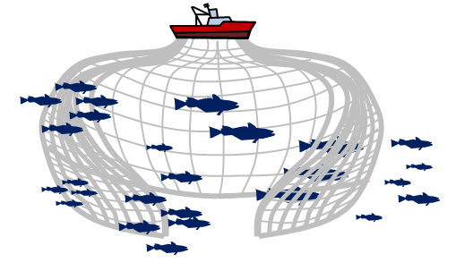
Web Application
The user selects a population ‘recruitment level’ (a believe about the impact of the recruits)
The application uses the steepness factor on a Beverton-Holt stock recruitment relationship
Recruitment level
MEDIUM
HIGH
MEDIUM
LOW
SPAWNING STOCK BIOMASS VS NUMBER OF RECRUITS
HIGH
[k*recruits]
MEDIUM
HIGH
MEDIUM
LOW
LOW
SSB [ktonnes]
[ Dynamic Function]
Initial Abundance Vector
Recruitment
Selectivity
Natural mortality
User Requirements

Slide 51
Web Application
The user selects an exploitation pattern
From database or logisitic curve
Exploitation pattern from database
Exploitation pattern from logistic curve
EXPLOITATION PATTERN
EXPLOITATION PATTERN
1.0
1.0
0.95
a_{50%}
8
SELECTIVITY
SELECTIVITY
0.50
a_{95%}
11
0.0
2 3 4 5 6 7 8 9 10 11 12 13
0.0
2 3 4 5 6 7 8 9 10 11 12 13
AGE
AGE
Initial Abundance Vector
Recruitment
Selectivity
Natural mortality
User Requirements

Slide 52
Web Application
The user enters a natural mortality value depending on the apparition of predators (Giant Squid)
Natural Mortality
Without Giant Squid (M = 0.33)
With Giant Squid (M = 0.63)
Other
M
[ Dynamic Function]
Initial Abundance Vector
Recruitment
Selectivity
Natural mortality
User Requirements

Slide 53
Web Application
User Requirements
Social required level for yield
[tonnes]
Required SSB prevention level
[tonnes]
Recovery Plan Analysis
Before the user enters data, the application shows thresholds for the user requirements, based on the scenario formulated from previous stages
ATTENTION
Under actual assumptions it is not possible to take a sustainable yield greater than 32180 [tonnes] or a prevention level for SSB greater than 306650 [tonnes].
To consider,
REQ ≤ 32180 [tonnes]
SSB_{min} ≤ 306650 [tonnes]
User Requirements

Slide 54
Web Application
User Requirements
Social required level for yield
30000
[tonnes]
RECOVERY PLAN ANALYSIS
Under actual assumptions, every recovery plan evaluated needs not less than 2 years of implementation.
Required SSB prevention level
[tonnes]
116000
Recovery Plan Analysis
ATTENTION
Under actual assumptions it is not possible to take a sustainable yield greater than 32180 [tonnes] or a prevention level for SSB greater than 306650 [tonnes].
To consider,
REQ ≤ 32180 [tonnes]
SSB_{min} ≤ 306650 [tonnes]
If the requirements are compatible, the application can start with the recovery plan analysis.
User Requirements

Slide 55
Web Application
Recovery
Plan
Recovery Plan Proposal Effects
Recovery Plan Proposal
Y
YIELDS/LANDINGS PER YEAR
30.0 [ktonnes]
The analysis suggest to consider a TAC of
23.6 [ktonnes] during 4 [years]
to recover the fishery.
This alternative minimize the cost with a 6.4 [ktonnes] tradeoff per year.
This leads to a total cost of 25.6 [ktonnes] during the entire period (4 years).
23.6 [ktonnes]
2011 2012 2013 2014 2015 2016 2017 2018
Recovery Plan
Sustainable Fishery
RESPECTIVE SPAWNING STOCK BIOMASS LEVELS PER YEAR
SSB
116.0 [ktonnes]
Social required level for yield by user (REQ)
Required SSB prevention level by user (SSB_{min})
TAC associated with the minimal cost recovery plan
Landings for ‘healthy fishery’ equal to REQ
2011 2012 2013 2014 2015 2016 2017 2018
Projection with a constant landing level equal to REQ

Slide 56
Web Application
Recovery
Plan
Alternative
Recovery Plans
POSSIBLE RECOVERY PLANS
Dissatisfaction level
(Total costs associated)
30.0 [ktonnes]
23.6 [ktonnes]
Social required level for yield by user (REQ)
TAC associated with
the respective recovery plan
TAC associated with
the minimal cost recovery plan
2 3 4 5 6 7 8 9 10
Implementation years to recovery

Slide 57
Transfering …
Our web application can be used freely
However, this version has some limitations that can be improved together with the stakeholders if needed
We expect this tool can be useful for artisan fishermen

Slide 58
Thanks!
Quantitative tools for the sustainable recovery
of the hake (Merluccius Gayi Gayi) in the Region
of Valparaiso, Chile
MABIES – IHP - 2013
More details about the project in
www.recuperemoslamerluza.cl

Slide 59
Theory
Dynamic function and
Optimization Problem
BASIC IDEAS
DIFFERENCE EQUATION
DYNAMIC FUNCTION
OPTIMIZATION
PROBLEM
: Discount factor
[ Recovery Problem]
[ Recruitment]
[ Natural Mortality]

