Slide 1
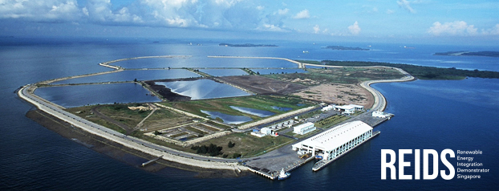
Optimization of multifluid microgrids,
the REIDS project in Singapore
Baptiste ROSSI | baptiste.rossi@engie.com | 31/05/2017, SESO-2017

Slide 3
In a nutshell
➔Target is to: Build microgrid management system for offgrid areas
➔REIDS is a Singapore based demonstrator & test bed
➔Various technologies (RE, Storage, Genset, H2, Gas, Water …)

Slide 4
Plan of the presentation
Presentation of the REIDS project :
specificities, assets
Optimization problems:
Many topics of today’s programme ☺
Multifluid synergies, Interoperability issues

Slide 5
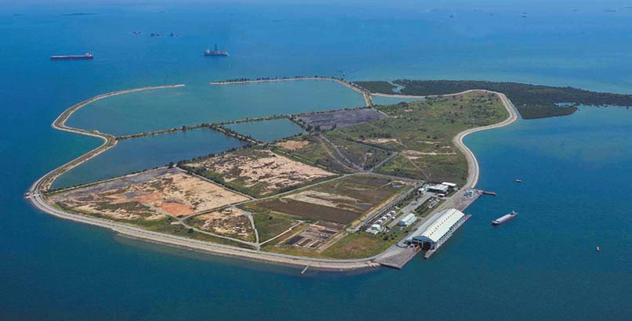
Specificities of REIDS
Public-Private consortium
4 Microgrids built by different partners
Solutions for off-grid microgrids:
Electrical islands
Telecommunication limited islands
Variety of assets: Genset, RnE, P2P, Desalination

Slide 6
Assets in REIDS Assets connected to Engie’s grid

Slide 7
Global objective: Local Energy Management System, decentralizing production and decisions
Grid
Local energy management system:
Driving the assets towards optimized behavior
Real time management of the grid:
Stability
Storage and RnE integration
On-grid/Off-grid services
Local decisions to be taken … locally
+ deployment constraints, cloud vs edge
Completely autonomous solution
Weather parameters
Local storage
Local production
RnE production
Local grid state

Slide 8
Plan of the presentation
Presentation of the REIDS project :
specificities, assets
Optimization problems:
almost all topics of today’s programme ☺
Multifluid synergies, Interoperability issues

Slide 9
Optimization problems, depending on time scales
μEMS –
Optimization multifluid :
Guiding the multifluid grid towards optimized KPIs
Combination of various problems:
Electrical:
Optimal Power Flow
Unit Commitment
Battery lifetime optimization
Economic Dispatch & Scheduling:
Storage, gas& other fluids: Targets, flexible loads
Engie EMS
PMS
Power control :
Stability, following commands given by EMS

Slide 10
Decomposition depending on time scale
Low level: <1min
Optimal power flow
Stability handling, reserves …
Matching targets from upper level
Usage Level: 1-15min for 24h
Dispatch and sizing of targets (eg Battery, H2 …)
Unit commitment
Battery ageing
MidTerm: multi-day horizon
Unit commitment, maintenance scheduling, longer term arbitrages
Predictive control
But stochastic will be better, especially for 2 last problems
Voltage, Frequency
Real time balancing
Production scheduling,
Storage strategy
Reserves & priorities
Production,
Maintenance,
Storage strategy

Slide 11
Plan of the presentation
Presentation of the REIDS project :
specificities, assets
Optimization problems:
almost all topics of today’s programme ☺
Multifluid synergies, Ontologies/Interoperability issues

Slide 12
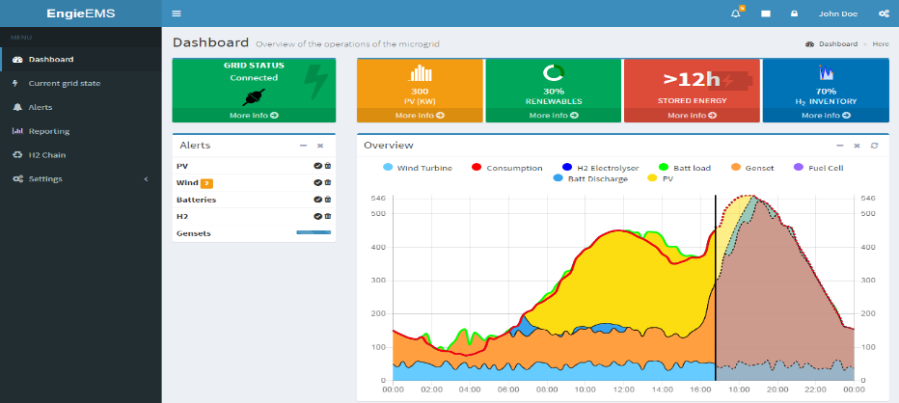
Interactions between different networks / energies
Various assets or systems to model and to control, each one having his own constraints and interactions with different fluids
➔ «Genericity» is key in the approach, a wide variety of assets to be modeled, project is to address wide range of situations and assess synergies
PV panels
Storage
H2
P2G
Heat pump
2
1
Windmills
Heat network
Electrical grid
Gas network
Water network

Slide 13
Value is in optimization, pain is in integration
Ontologies, optimization and interoperability
Input data:
Grid description
Forecasts
Data on assets
Assets have a « Type »
Generate model and equations, parameters and solving algorithm
Results / set points for assets
Targets from Control problem
Real time data from sensor
Setpoint to asset
Each asset has its own interface / controller / telco protocol, rules to access …
Ontologies and standardization is key in energy to make it work
It is somewhat common in modeling & optimization, key for rules engine and cascading orders.

