Slide 1



renewable energy aggregator
- how to handle market risk -
Ariel Waserhole
Francis Sourd
Davy Marchand-Maillet
Pierre Carpentier
Jean-Philippe Chancelier
Michel De Lara
Vincent Leclère
&
SESO’16

Slide 2
Sun’R Smart Energy and the Sun’R group
A compact team of RES & Energy Storage enthusiasts

Slide 3




The Sun’R group develops and operates GHG-free energy assets to facilitate the transition to a sustainable electrical system
Sun’R
Sun’R Smart Energy is part of the Sun’R group, evolving from a pure player in the solar PV generation to a larger position on the value chain.
In France :
Paris
➔ Innovation in technology: distributed high efficiency, “grid-scale” and flexible storage units
  Flexible pumped hydro
  Isothermal CAES
  And a third undisclosed “early stage” technology
➔ Storage projects deployment: supplying territorial/regional storage needs (~10.000s of inhabitants)
  Grid needs assessment towards renewable integration
  Units engineering with high environmental compatibility
  Fast and open financing, rigorous building
  Centralized operation et maintenance
➔ « Variable RES + Storage » aggregator:
  Monetizing energy assets (generation & storage)
  Supplying services to the electrical system
Lyon
Montpellier
… and
internationally !
Solar PV generation
> 25 professionals strongly involved in the energy transition
> 60M€ invested in 7 years
RES + Storage
aggregation
Infrastructure financing

Slide 4
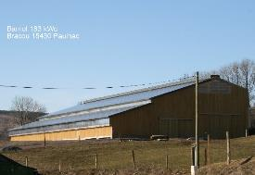

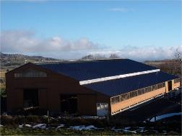

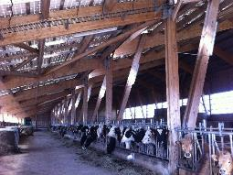
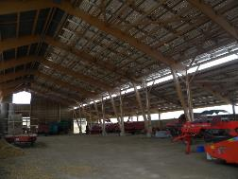
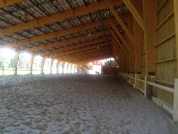
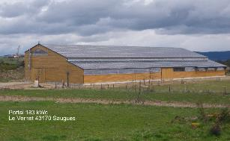
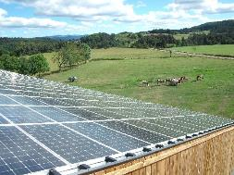
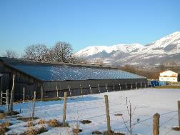
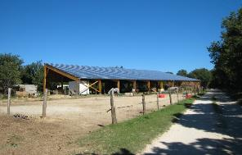
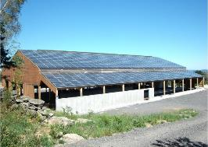
Sun’R has developed 120+ solar PV power plants, and operates 70+ on its own behalf
Sun’R

Slide 5


SunHydrO – Distributed Pumped Hydro Storage
Small is beautiful !

Slide 6
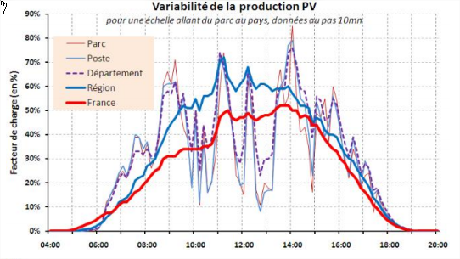
Tackle the issues where they mostly occur
The « profusion effect » is beneficial at a large scale but conceals the strong variability at the park or 20kV/60kV transformer station
RES integration management will become critical
At national/European level : only in case of strong dephasing
At local level : continuously tricky due to intermittency

Slide 7










Agile partners to bring flexibility to the electrical system
Data management
RES generation forecast
Solar PV generation
Innovation management
Aggregator
Hydro engineering
Optimal control R&D
Civil engineering
Electrical engineering
Turbines

Slide 8




The SunHydrO project aims to couple renewable generation with storage to supply electricity and energy services to the system
Context
Energy assets
Aggregation
Electricity markets
Distributed renewable and variable generation sources
Wholesale market
Short and Very Short Term Forecast
Solar PV
Wind
Solaire PV
Solaire PV
Solaire PV
Solaire PV
Solaire PV
Solaire PV
Solaire PV
Balancing Market
Stochastic
Programming
Monitoring & Control
Capacity Market
Electricity Storage Assets (+DSM)
Stockage
Stockage
Storage
Ancillary Services
Flexibility control
Network savings
(OPEX & CAPEX)
Modeling & Operation
Energy & Services sales

Slide 9
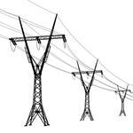




>>> Renewable Energy Sources (RES) aggregator
> A new actor for energy transition
Context
Commitment
(production plan)
Network operator
Energy market
Pay
fixed price
Produce
Pay imbalance
Sell ahead
Variable RES
World is changing (EU directive)
  RES feed-in-tariffs are over
  RES producers have now to face markets
Units
€
MWh
Notes:
C(W)

Slide 10
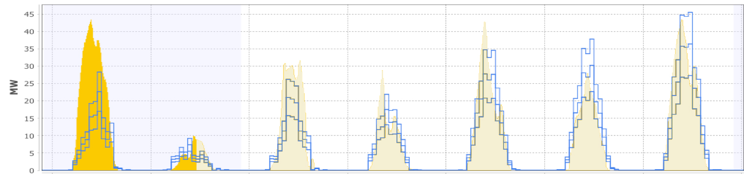
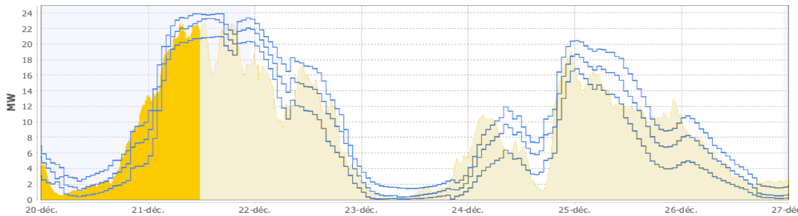
>>> How to master RES variablity on spot market?
> Selling ahead a variable energy
Context
past future
?
Forecasts at J-1 12h
Day-Ahead market :
A commitment at noon to deliver
an energy the day-after
Production
Problem: the RES production is unknown
?

Slide 11
>>> Renewable Energy Sources (RES) aggregator
> A new actor for energy transition
Context
Commitment
(production plan)
Network operator
Energy market
Pay
fixed price
Produce
Pay imbalance
Sell ahead
Variable RES
World is changing (EU directive)
  RES feed-in-tariffs are over
  RES producers have now to face markets
Units
€
MWh
Notes:
C(W)

Slide 12

>>> Renewable energy aggregator
> A new actor for the energy transition
Contexte
Commitment
(production plan)
Network operator
Energy market
Produce
Pay imbalance
Buy/Sell
Pay
contractual
price
Aggregator
Flexibility assets
Variable RES
Aggregator’s role
  Pay the RES producer a contractual price
  Face markets
    Handle risk exposition
      Production imbalance
      Market prices
Units
€
MWh
Notes:
C(W)

Slide 13
>>> Renewable energy aggregator : How to handle market risk
> Agenda
Contexte
Commitment
(production plan)
Network operator
Energy market
Produce
Pay imbalance
Buy/Sell
Pay
contractual
price
Aggregator
Flexibility assets
Variable RES
Presentation & models for base components
Aggregator’s optimization problem
  Maximization of expected revenue
  Extension to risk measures
Units
€
MWh
Notes:
C(W)

Slide 14
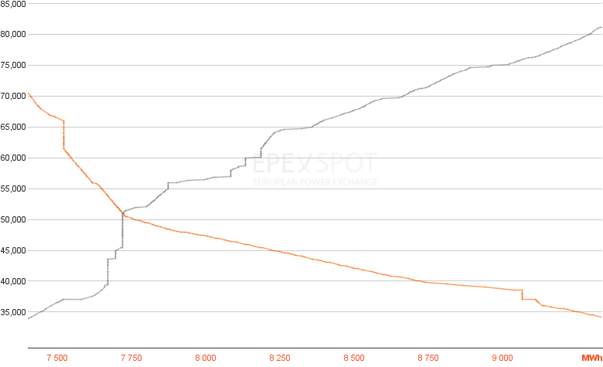
Day-Ahead market
> Energy market price for October 3rd 0h00
Market model
Price
€ / MWh
Accepted
bids
Refused
bids
Supply curve
Bids to sell energy
1 bid = 1 price
1 quantity
Unique market
Price
50,98€
Demand curve
Bids to buy energy
Exchanged volume
7720MWh
Source : www.epexspot.com
Volume
MWh

Slide 15
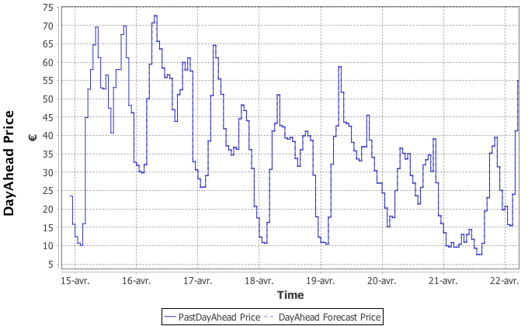
Day-Ahead market
> One bid auction the day before
Market model
Unlimited bid model
Bidding 24 quantities
Deterministic decisions
Bought/Sold at unknown market prices
Random variables
Gain
Spot market
One price per hour of delivery
On bid turn at 12h00 forJ+1
Notes:
(\vda_1,\dots,\vda_{24})
\E \left[ \sum_h \vda_h \vpda_h \right]

Slide 16
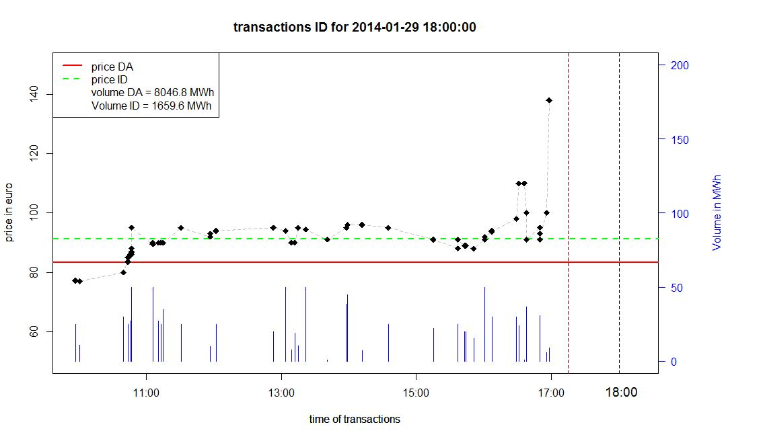
Intraday market : Over the counter
> A recourse
Market model
One Intraday transaction
Weighted average Intraday price
price
DayAhead price
volume
Hour of delivery

Slide 17
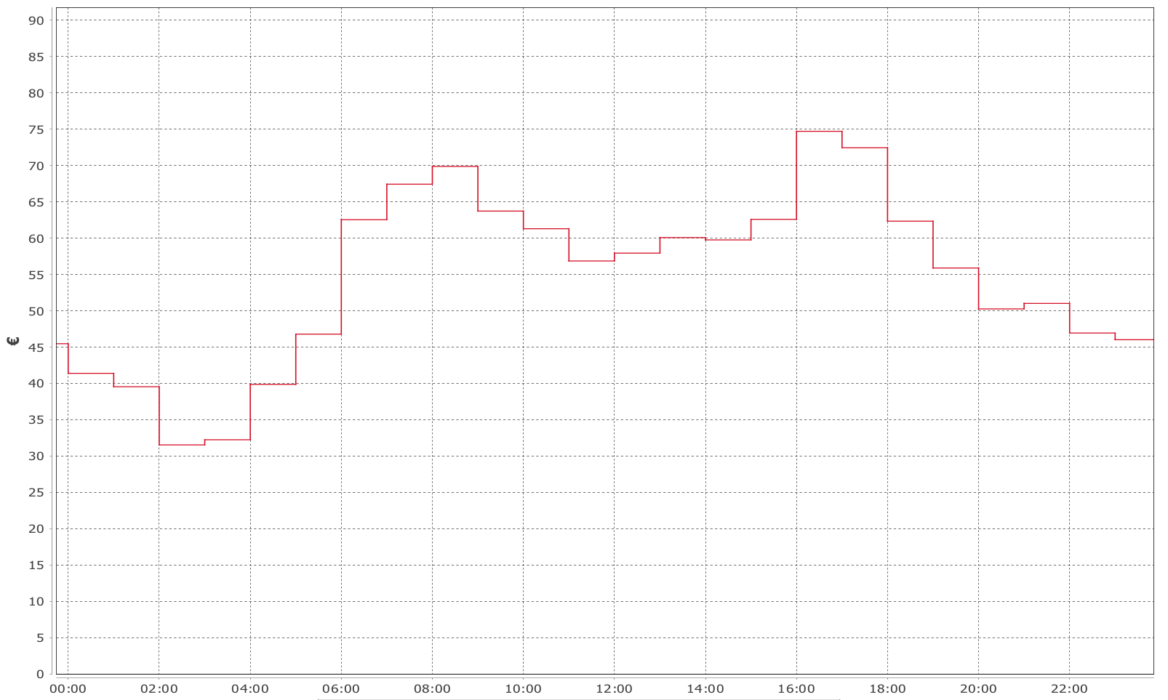
A simple Intraday market model
> Selling at the weighted average price one hour before delivery
Market model
Simple market model
Bidding a quantity at h-1 for h
Stochastic decision
Bought / Sold at the average market price
Random variable
Accepted following market’s liquidity
Random variable
  Gain
Weighted average Intraday price
Each hour, one bid for delivering an energy on the next hour
Notes:
\E \left[ \sum_h \vid_h \vL_h \vpid_h \right]

Slide 18
Stochastic optimization notations
Random variables are denoted in BOLD CAPITAL LETTERS
Realization of random variables are denoted in regular small letters
Non anticipativity constraints are denoted
  With the available information at hour h-1
    Random decision variables or stochastic decisions are functions of the available information

Slide 19
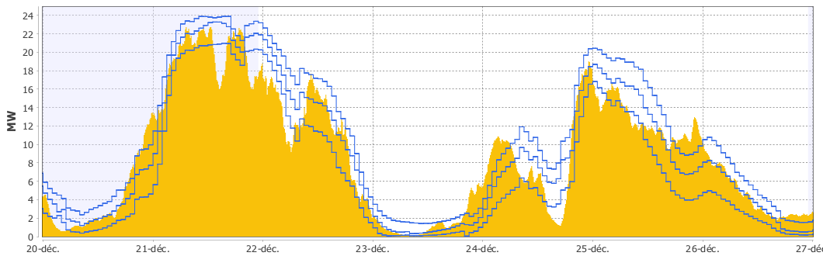
Variable RES model
RES model
RES production
Stochastic process
Random variable
RES production cost
Cost
3 « forecasts »
= 3 samples of the
modeled stochastic process
= The « real » production
is one « special » realization
of the stochastic process

Slide 20
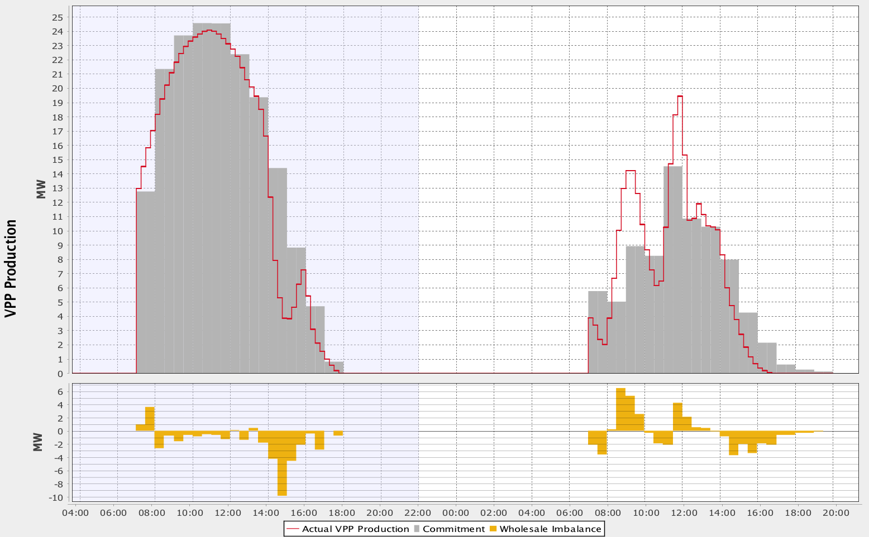
Network is watching
> Imbalance between production and commitments
Network
model
Variable RES production
Market commitment
Imbalance cost
Imbalance prices
Random variables
« Gain »
With
Imbalance
Notes:
&\vecart_{h} = \vpv_{h} - \left( \vda_{h} + \vid_{h-1,h} \right)\\
&\vecartP_{h} \geq 0, ~\vecartN_{h} \geq 0\\
\vecartP_{h} \vprep_{h} - \vecartN_{h} \vpren_{h}

Slide 21
RES aggregator’s expected revenue maximization
> Multi-stage stochastic program
Optim’
(Bid gain)
(Imbalance cost)
(RES cost)
(Imbalance)
(Recourse)
😀 Linear formulation
😡 5 random variables highly correlated
> one to another
> in time
Notes:
\max_{\substack{ \da_{h} \\ \vid_{h} }}~&
\E \left[
\sum_{h}
\bigg(
\da_{h} \vpda_{h}
+ \vid_{h} \vL_h \vpid_{h} + \vecartP_{h} \vprep_{h} - \vecartN_{h} \vpren_{h} - \bm{P}^W_h\vpv_h)
\bigg)
\right]
\\
\st &\vecart_{h} = \vpv_{h} - \left( \da_{h} + \vid_{h} \vL_h \right) & \forall h\\
& \vid_{h} \preceq \F_{h-1} & \forall h
\max_{\substack{ \vda_{h} \\ \vid_{h} }}~&
\E \left[
\sum_{h}
\bigg(
\vda_{h} \vpda_{h}
+ \vid_{h} \vL_h \vpid_{h} + \vecartP_{h} \vprep_{h} - \vecartN_{h} \vpren_{h} - c(\vpv)
\bigg)
\right]
\\
\st &\vecart_{h} = \vpv_{h} - \left( \vda_{h} + \vid_{h} \vL_h \right) & \forall h\\
& \vda_{h} \preceq \F_{j-1, 12h}, ~\vid_{h} \preceq \F_{h-1} & \forall h
\vda_{h} \preceq \F_{j-1,h} \Rightarrow \vda_{h} = \pi(\F_{j-1,h})
\vid_{h} \preceq \F_{h-1} \Rightarrow \vid_{h} = \pi(\F_{h-1})

Slide 22
We have a formulated a res aggregator optimization problem
➔ How to solve it?
Stochastic programming

Slide 23
Stochastic programming
> Solving with Linear Programming on a scenario tree
Optim’
12h
12h45
J+1 0h00
J+1 24h00
Day-Ahead
Intraday
Pilotage fin
1 scenario

Slide 24
We now have tools to take res aggregator decisions
➔ How does these decisions behave in real life?
Simulation

Slide 25
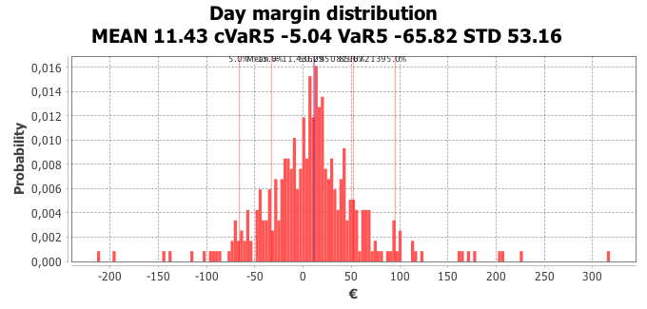
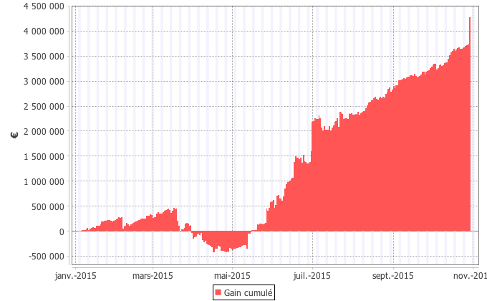
Simulation of Day-Ahead/Intraday aggregator’s selling strategy
> A large variance
Optim’
Expected gain
Losses
Daily gain distribution
€
€
Bankrupt?
Cumulated gain
time

Slide 26
How to model risk?
> Value at Risk (VaR) & Conditional VaR (CVaR)
Optim’
Probability
and
Gain
→ probability to have a gain less than this value
→ not linear
= the expected gain in the worst « % » of cases
→ more sensitive to the distribution’s shape
→ can be linearized
Notes:
\cvar_\beta[\bm{X}] = \frac 1 \beta \int_{-\infty}^\beta \vvar_\beta[\bm{X}] d\theta
\Prob(\bm{X} \leq \vvar_\beta[\bm{X}]) = \beta

Slide 27
RES aggregator’s risk averse optimization problem
> Looking for a risk/gain balance
Optim’
(Expected gain)
(Risk)
with
the random variable representing the daily gain
Notes:
\max_{\substack {\da_h \\ \vid_h }}~ & \alpha \E[\vm] + (1-\alpha) \cvar_\beta[\vm]\\
\st &\vm= \sum_h \bigg[ \da_{h} \vpda_{h}
+ \vid_{h} \vL_h \vpid_{h}
+ \vecartP_{h} \vprep_{h} - \vecartN_{h} \vpren_{h} - \bm{P}^W\vpv
\bigg]
\\
&\vecart_{h} = \vpv_{h} - \left( \da_{h} + \vid_{h} \vL_h \right) \\
& \vid_{h} \preceq \F_{h-1}
\max_{\substack {\vda_h \\ \vid_h }}~ & \alpha \E[\vm] + (1-\alpha) \cvar_\beta[\vm]\\
\st &\vm= \sum_h \bigg[ \vda_{h} \vpda_{h}
+ \vid_{h} \vL_h \vpid_{h}
+ \vecartP_{h} \vprep_{h} - \vecartN_{h} \vpren_{h} - c(\vpv_h)
\bigg]
\\
&\vecart_{h} = \vpv_{h} - \left( \vda_{h} + \vid_{h} \vL_h \right) \\
& \vda_{h} \preceq \F_{j-1, 12h}, ~\vid_{h} \preceq \F_{h-1}

Slide 28
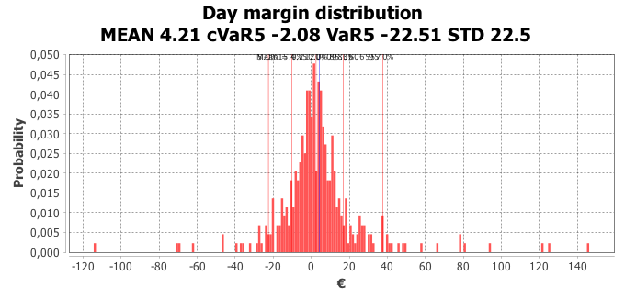
Simu’
>>> Two different daily gain distributions
Risk neutral strategy
€
Losses >100€
€
Risk averse strategy

Slide 29
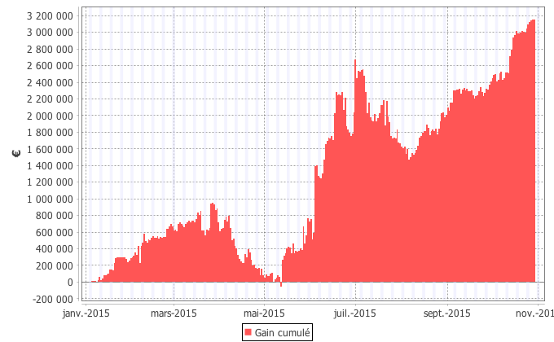
>>> Risk model can master risk!
> less gain but less risk
Simu’
Risk neutral strategy
Risk averse strategy
Daily gain distribution
Cumulated gain

Slide 30
Conclusion
We proposed a stochastic framework for the RES aggregator’s problem
  A rather realistic Day-Ahead market model
  A simple Intraday market model
We conduced simulations
  We demonstrated the benefit of using a risk measure
  We showed the relevance of even a simple Intraday market model
These tools are used for a more general RES aggregator problem with storage

Slide 31
Aggregator dash-board

Slide 32


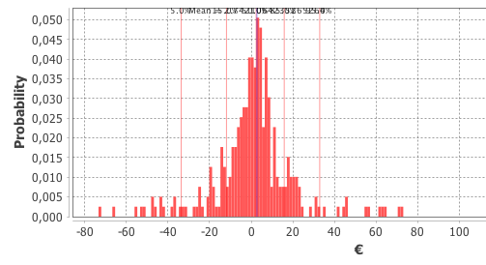
>>> Le métier de l’agrégateur d’EnR intermittentes
Recap’
Produit
Engage
(plan de production)
EnR intermittente
Monitore
Réseau
Marchés de l’énergie
Paie écarts
plan production
Achète
Rémunère
Vend
Agrège
Agrégateur
Accumule (+-)
Unités
Couvre
€
MWh
Trésorerie
Garant
Notes:
\bm{P}^W\vpv

Slide 33
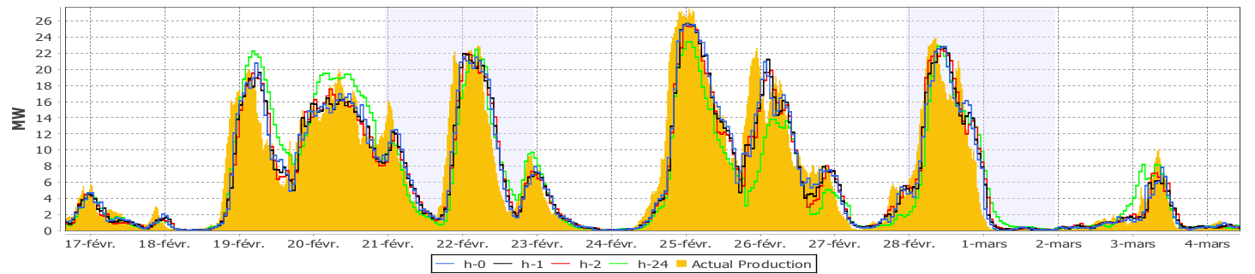
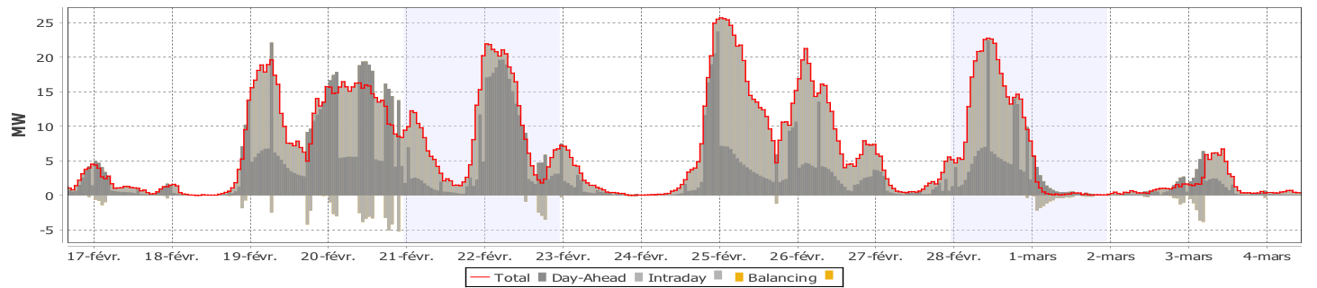
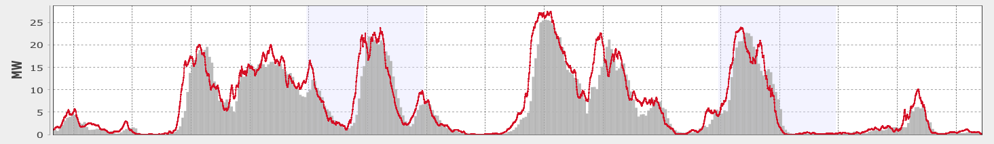
Quelle est la performance de vos prévisions?
Prévision de production EnR éolienne
Tirage v.a.
Production
réalisé
Vente sur les marchés Day-Ahead et Intraday
Vente sur le Day-Ahead
Vente sur le Intraday
Engagement
Plan de marche
Production
Engagement
Écarts
Écart par rapport au plan de marche

